Slide 1


PRESENTATION TITLE
EGEC 180 – Digital Logic and Computer Structures
Spring 2024
Lecture 12: Gated Latch and D Latch Design
Rakesh Mahto, Ph.D.
Office: E 314, California State University, Fullerton
Office Hour: Monday and Wednesday 2:00 - 3:30 pm
Or by appointment
Office Hour Zoom Meeting ID: 891 2907 5346
Email: ramahto@fullerton.edu
Phone No: 657-278-7274

Slide 2
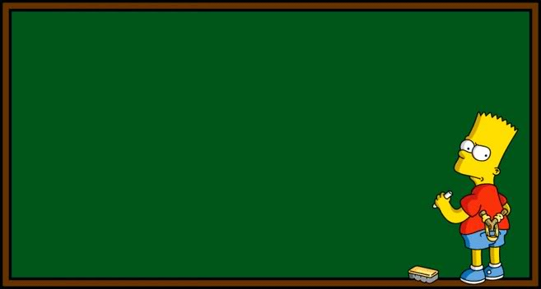
Gated Latch and D Latch Design

Slide 3
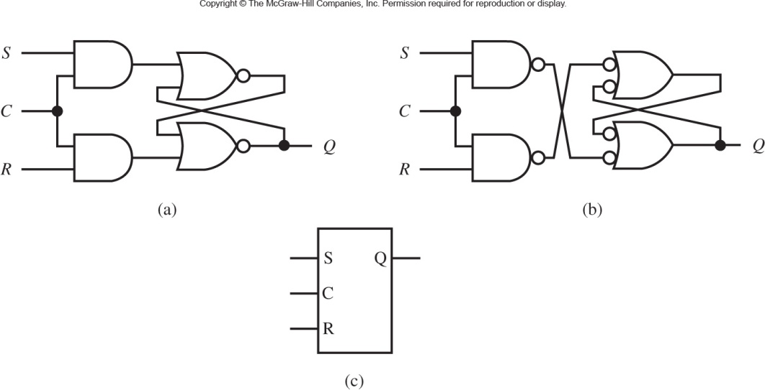
Gated Latch
With S-R NOR Latch
C = 0 implies hold
With S-R NAND Latch
C = 1 implies hold
Logic Symbol
A gated latch circuit can be created by adding a control input C to an S-R latch circuit.
The control input is used to retain or hold the present-state output value.
A gated latch circuit is level sensitive (output depends on logic level at input).
Notes:
Homework 1 was due last Thursday, so students still have until this Thursday to get credit with a late penalty.

Slide 4
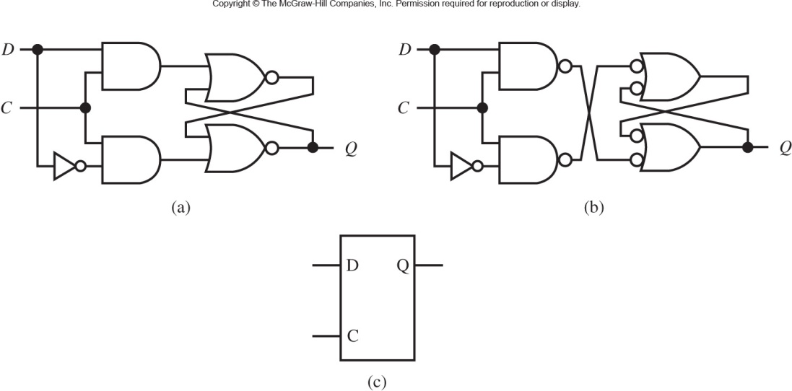
D Latch Circuit Design with S-R Latches
With S-R NOR Latch
With S-R NAND Latch
With NOT gate S cannot be equal to R.
D Latch or DATA Latch
Logic Symbol

Slide 5
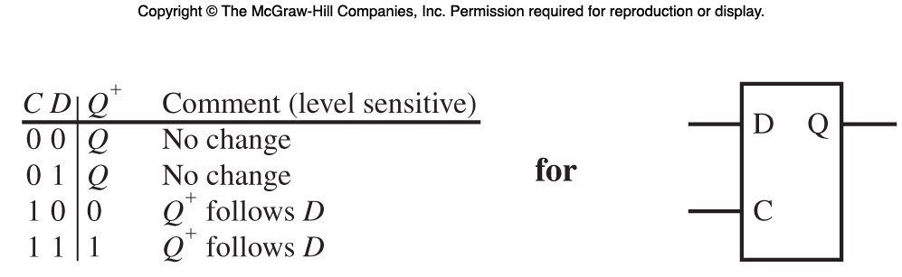
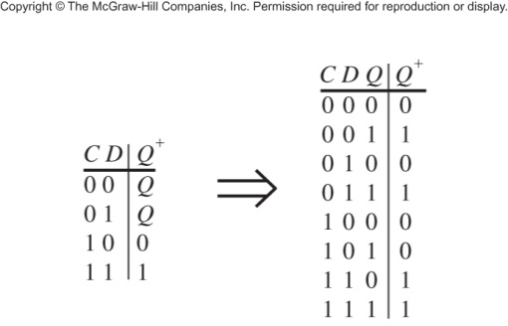
Characteristic Table for D Latch
PS/NS Table
If C = 1 then Q⁺ = D
Notes:
present state/next state

Slide 6
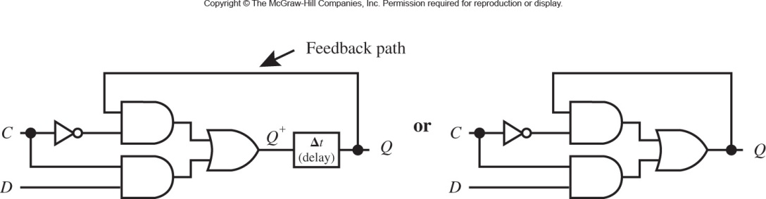
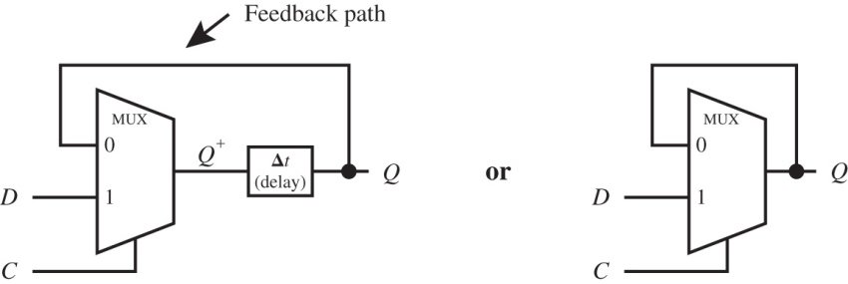
Reduced AND/OR Circuit for a D Latch
Q⁺ = C’Q + CD
2-to-1 MUX Equation: Z (output) = A′I₀ + AI₁
A is select line, I₀ and I₁ are input lines.
Q⁺ = C’Q + CD; C = A

Slide 7
Setup-Time and Hold-Time
Setup-Time, t_{su}: Required time before a clock pulse that an input signal must be settled
Hold-Time, t_{h}: Required time after a clock pulse that an input signal must remain settled
Sampling-Interval, t_{si}: Setup-Time + Hold-Time
Metastable State: Indeterminate value, not a stable 0 or 1

Slide 8
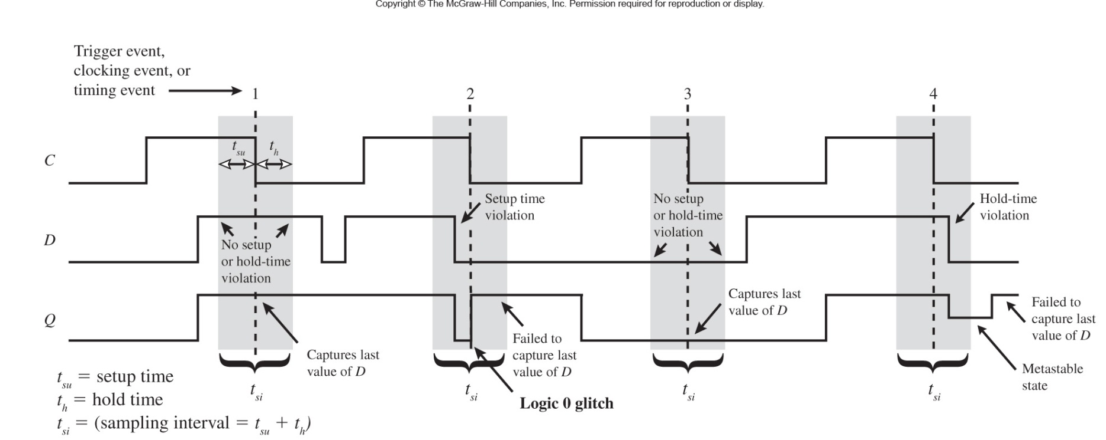
Timing Diagram for a D Latch
To avoid circuit malfunction D must be constant during the entire sampling interval t_{si}
Observe: Setup-time violation, Hold-time violation, Logic 0 glitch, and Metastable state

Slide 9
Setup-Time and Hold-Time
How can one fix a Setup-Time and Hold-Time violation?
Setup-time violation can be fixed simply by slowing down the clock
Hold-time violation can be fixed by adding delay before the input. Can’t be fixed after fabrication (chip-killer)!

Slide 10
Flip-Flops

Slide 11
Edge-Triggered D Flip-Flop
A D flip-flop has two inputs, D (data) and Ck (clock). The small arrowhead on the flip-flop symbol identifies the clock input. Unlike the D latch, the flip-flop output changes only in response to the clock, not to a change in D.
If the output can change in response to a 0 to 1 transition on the clock input, we say that the flip-flop is triggered on the rising edge (or positive edge) of the clock.
If the output can change in response to a 1 to 0 transition of the clock input, we say that the flip-flop is triggered on the falling edge (or negative edge) of the clock. An inversion bubble on the clock input indicates a falling-edge trigger.

Slide 12









D Flip-Flops
$$D$$
D
Q
$$A$$
Write back
$$Clk$$
Write back
Write back
Write back
$$Clk$$
$$D$$
Positive Edge Triggered FF
$$A$$
$$D$$
D
Q
$$B$$
$$B$$
$$\overline{Clk}$$
Negative Edge Triggered FF

Slide 13
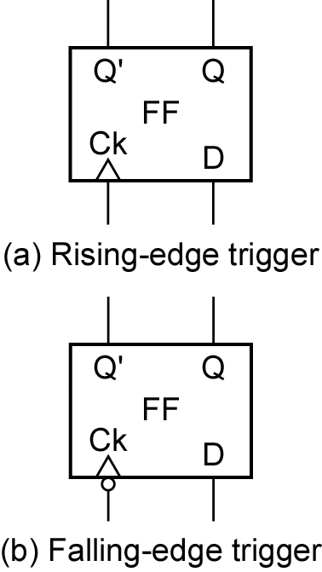
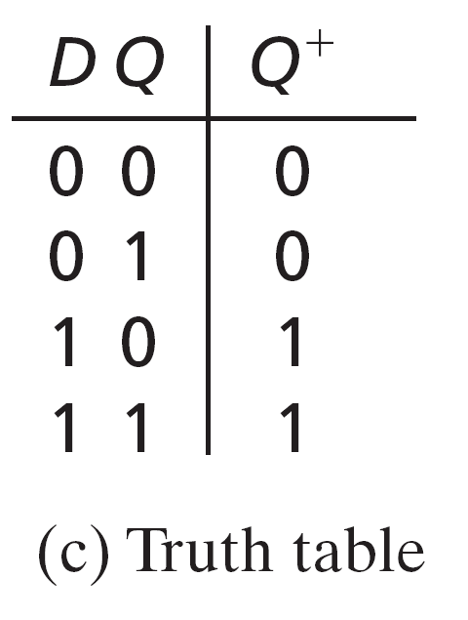
D Flip-Flops
+
Q = D

Slide 14
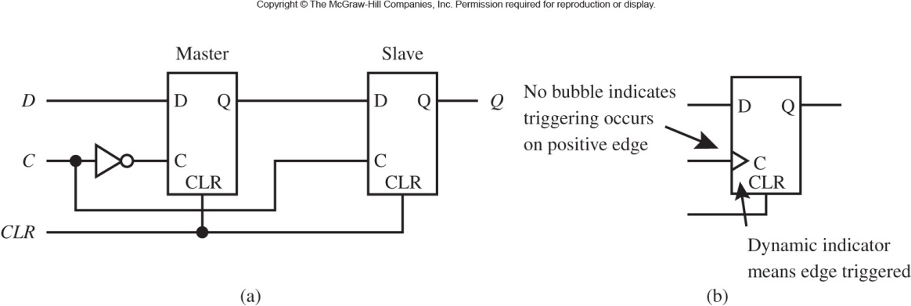
Positive Edge-Triggered D Flip-Flop with CLR Input
Master-Slave D FF: no transparent or see-through mode.
A Flip-Flop is specifically designed so that its output will not break into oscillations when feedback is added externally around it because it is edge triggered, as opposed to the D Latch which is level sensitive.

Slide 15
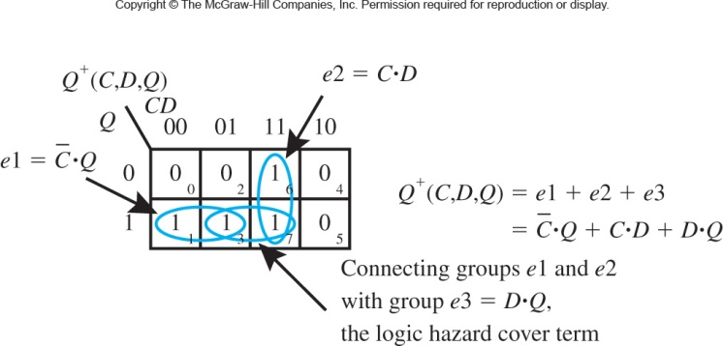
Manual K-Map Reduction for Q⁺
Consensus term removes the logic glitch: DQ.

Slide 16
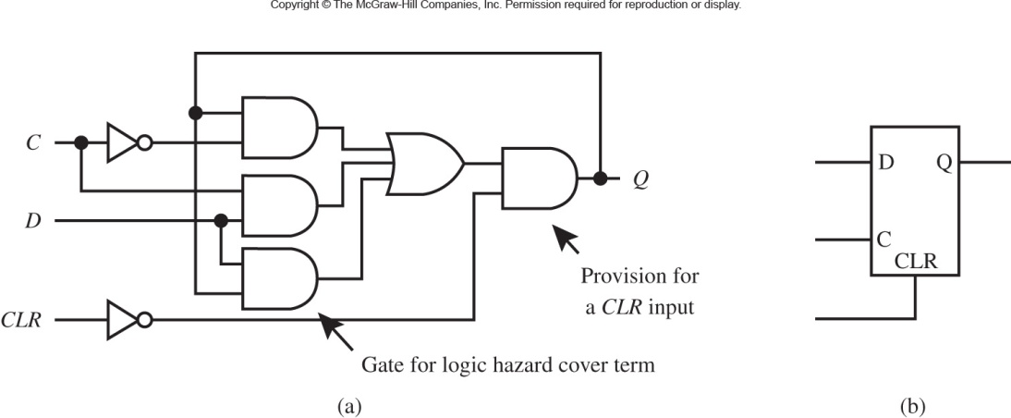
D Latch with a CLR Input: a) implemented with a logic hazard-free function in AND-OR circuit form, and b) logic symbol
Extra term removes the logic glitch: C’Q + CD + DQ

Slide 17
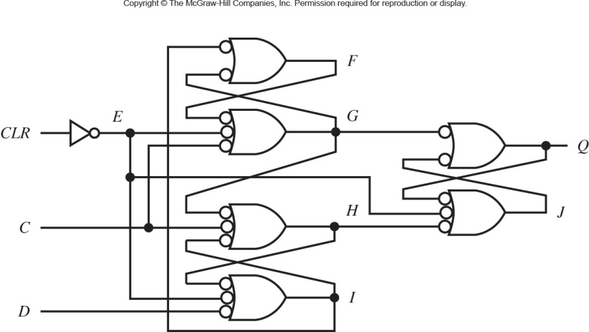
Annotated Gate Level Circuit for a Positive Edge-Triggered D FF with a CLR Input Implemented with Three S-R NAND Latches and a NOT Gate

Slide 18
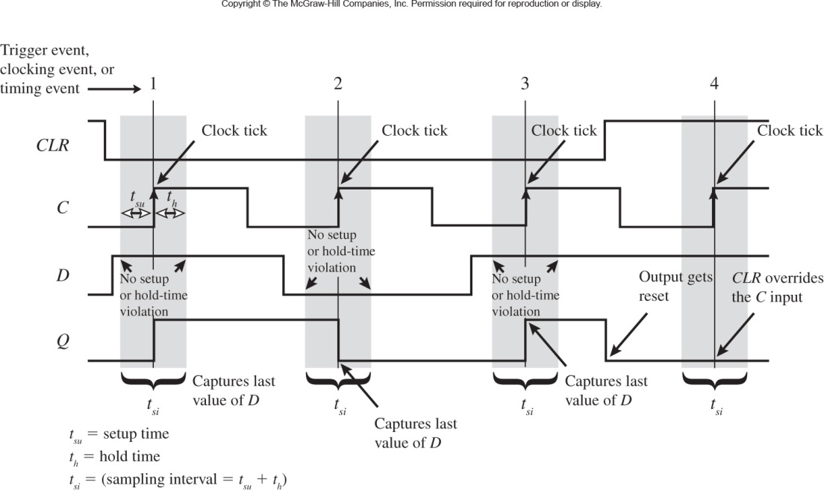
Timing Diagram for a Positive Edge-Triggered D FF

Slide 19
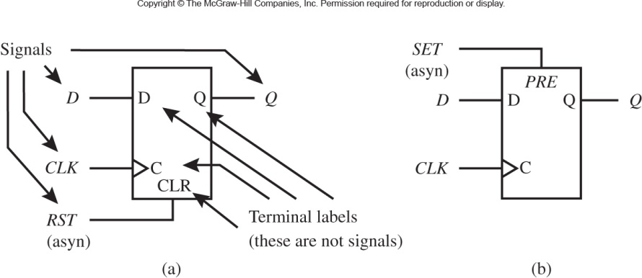
Logic Symbol for a Standard D Flip-Flop:
CLR is an asynchronous signal for CLEARING (CLR)
PRE is an asynchronous signal for SETTING
CLR or Reset (RST) and PRE or Set (SET) are active high; logic 1
Asynchronous implies clock (CLK) independent

Slide 20
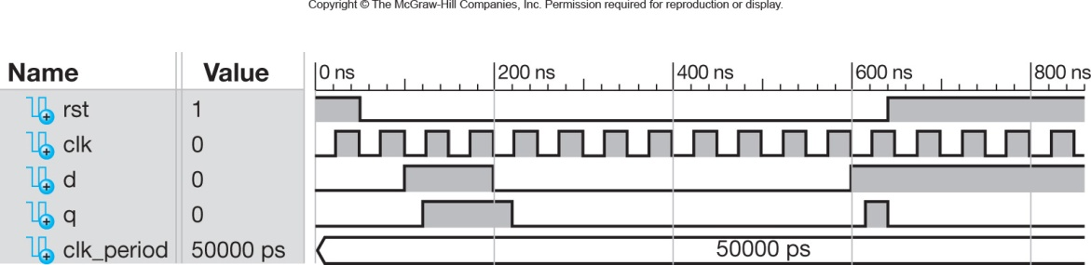
Simulation for the DFF Design
Note: raising edge of clock is when Q changes.
RST = 1 D and Q are 0

Slide 21
Q&A

